Slide 1


HUSH HUSH Recruiter-Hiring Process
Presented by Team05
1.Shariyar Babbaki
2.Mohammadreza Yazdankhah
3.Supriya
4.Paria Abassi

Slide 2
TABLE OF CONTENTS
01
02
INTRODUCTION
APPLICATION WORKFLOW
03
04
05
TEAM TASK
IMPLEMENTATION
FUTURE STEPS

Slide 3


APPLICATION WORK FLOW
STEP 1
STEP 3
STEP 5
STEP 2
STEP 4
FETCH DATA
PREPARE
PROCESS
NOTIFY
SELECT
Data cleaning& Sorting
Implementation of Machine learning algorithm
Notifying the users and sending Test file
Selection of candidate
User data is collected using web scrapping and APIs

Slide 4
Application |TEAM TASK ALLOTMENT
DATA COLLECTION
DATA PREPARATION
Mohammad reza & Supriya Nayak
Shariyar Babaki
ML IMPLEMENTATION
NOTIFYING CANDIDATE
Shariyar babbaki & Mohammad Reza
Paria Abbasi
SENDING QUESTION
SELECTION
Mohammad Reza
Paria Abbasi & Shariyar

Slide 5
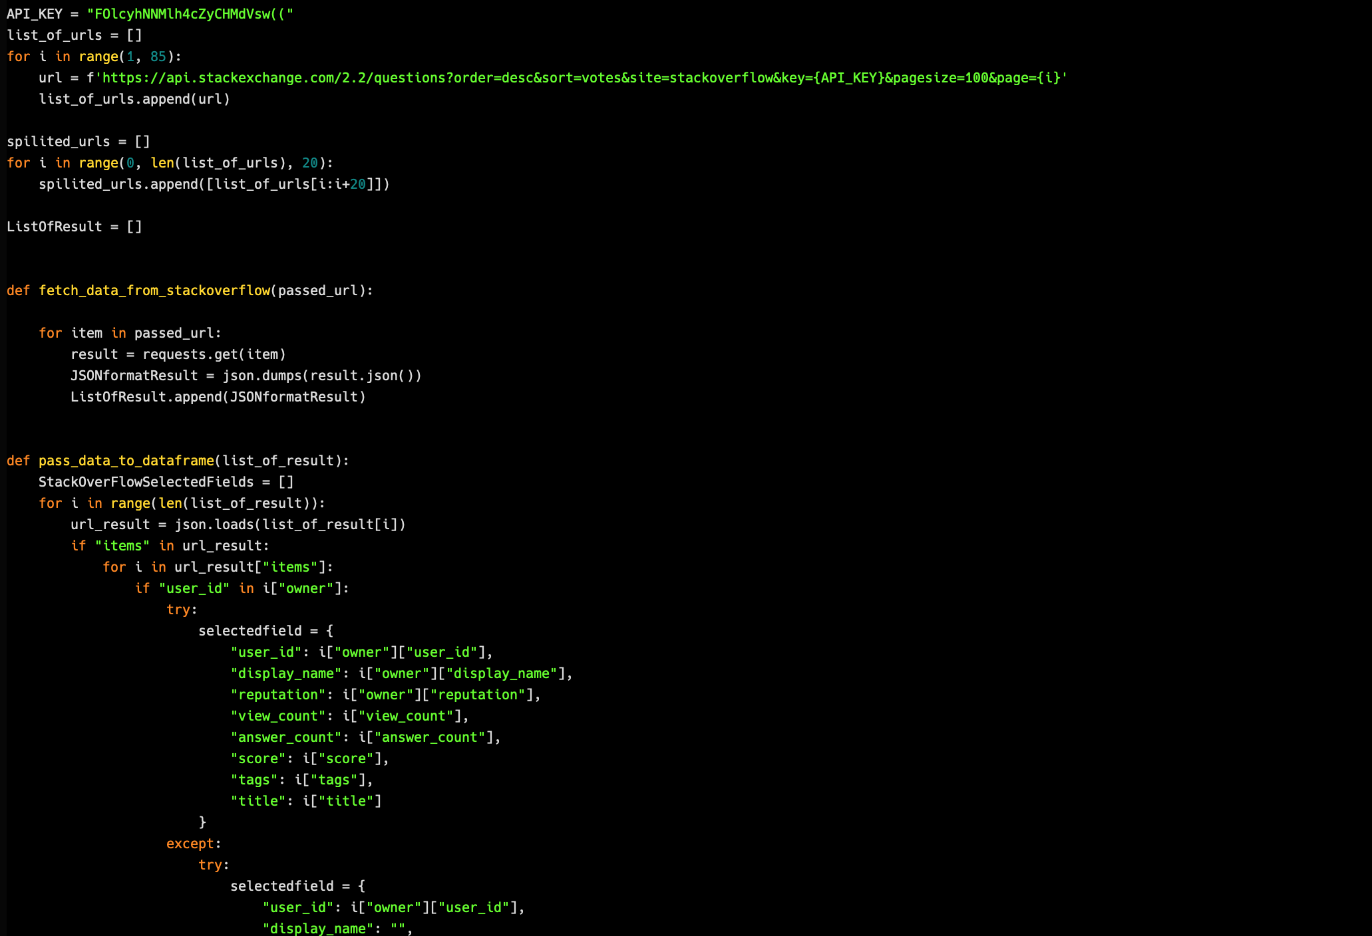
CODE IMPLEMENTATION
DATA COLLECTION
Data Source- Stack overflow and Github
API - Stackexchange

Slide 6
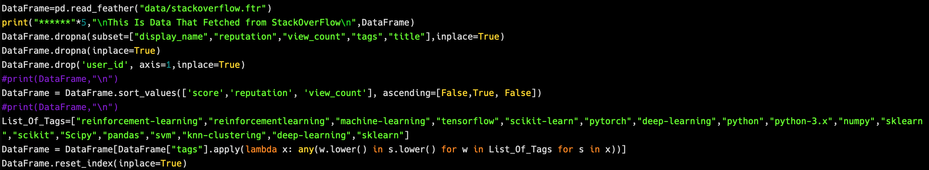
CODE IMPLEMENTATION
DATA PREPARATION
Data Sorting & Cleaning

Slide 7
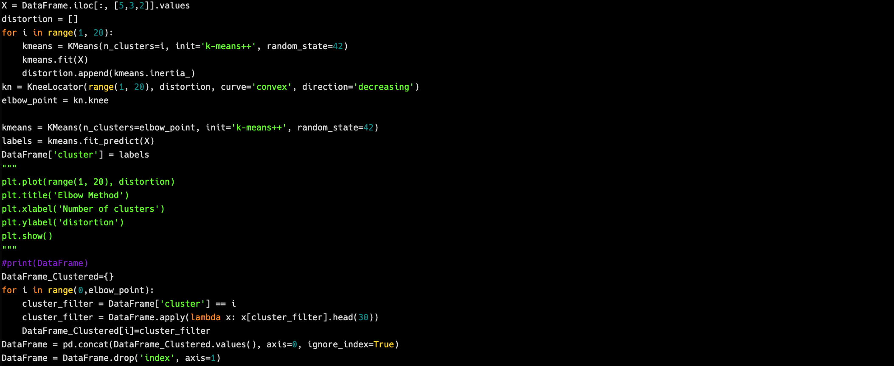
CODE IMPLEMENTATION
MACHINE LEARNING IMPLEMENTATION
Algorithm Used- K Nearest algorithm

Slide 8
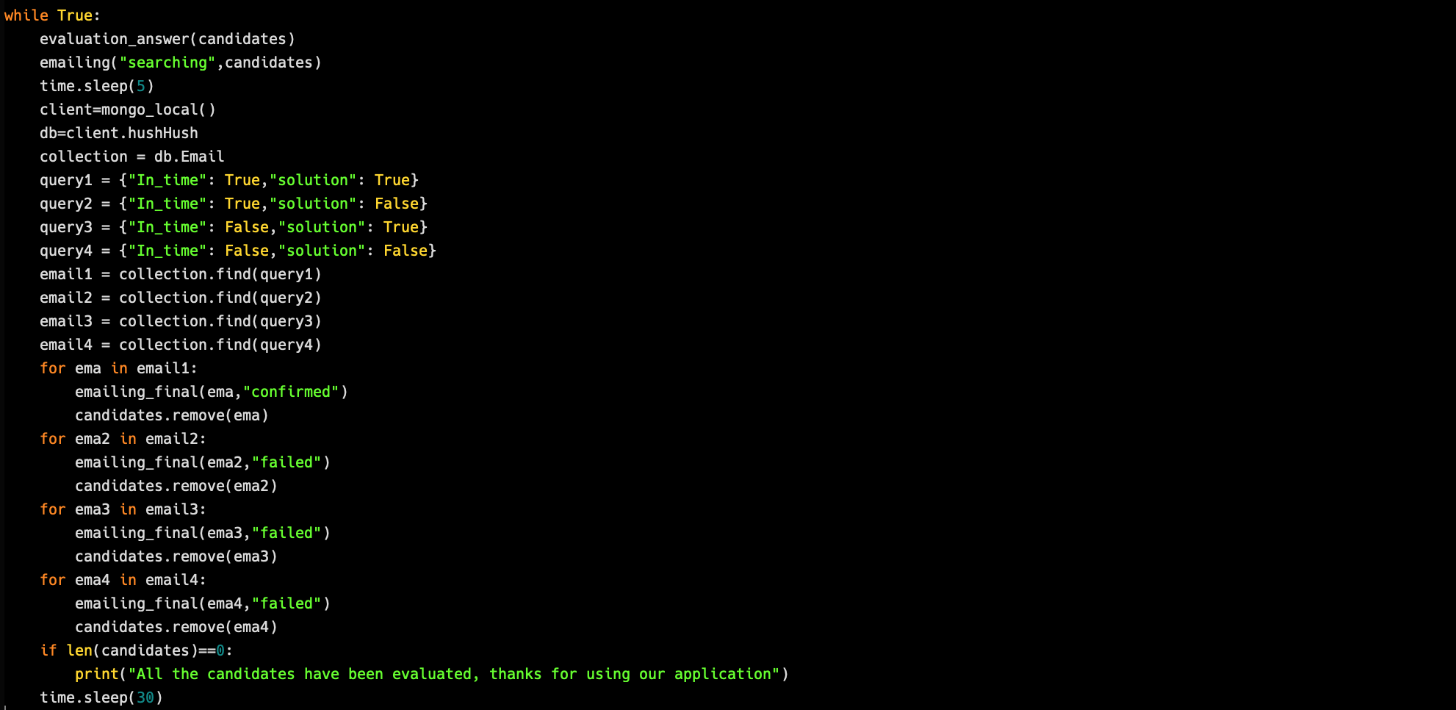
CODE IMPLEMENTATION
AUTOMATION

Slide 9
CODE IMPLEMENTATION
EMAIL NOTIFICATION

Slide 10
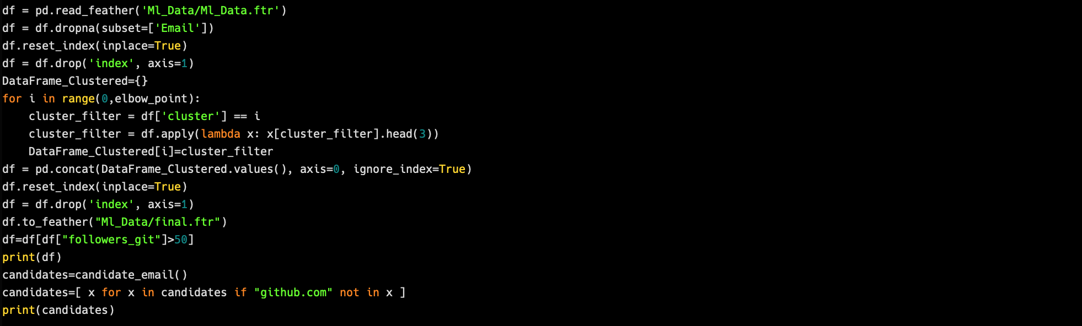
CODE IMPLEMENTATION
SELECTION

Slide 11
FUTURE STEPS TO KEEP LEARNING
Collect data from more diverse sources
Design GUI for code testing
Optimize the machine learning algorithm
Expedite Background Checks

Slide 12

VIELEN DANKE !!

